Slide 1
Bio& 241 A&P 1 Unit 3 / Lecture 2

Slide 2
Functions of the Muscular System
Produce body movements
Stabilize body positions
Regulate organ volume
Move substances within the body
Produce heat (thermogenesis)

Slide 3
Properties of Muscle Tissue
Electrical excitability
(electrical impulses called action potentials)
Contractility
a. Isometric contraction: No shortening of muscle
b. Isotonic contraction: Shortening of muscle
Extensibility (stretch without being damaged)
Elasticity (return to its original shape)

Slide 4
Three Types of Muscle Tissue that comprise the Muscular System
Skeletal muscle: creates the movement associated with bones and joints.
Smooth muscle: associated with hollow organs, blood vessels, and ducts.
Cardiac muscle: found within the heart where it creates the pumping action of the heart.

Slide 5
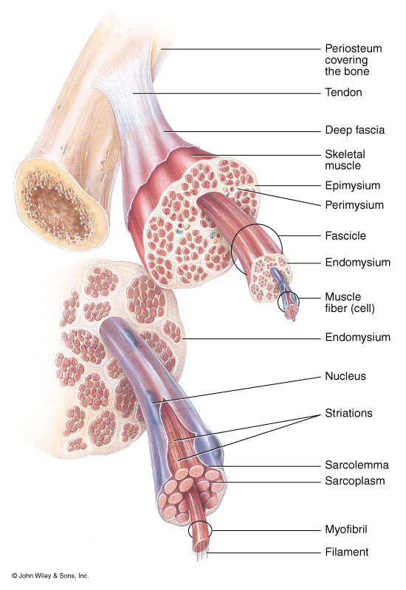
Organization of Skeletal Muscles at the gross level
CT layers
Directly associated
With muscles:
Epimysium
Perimysium
Endomysium
Other CT
Fascia
Aponeurosis

Slide 6
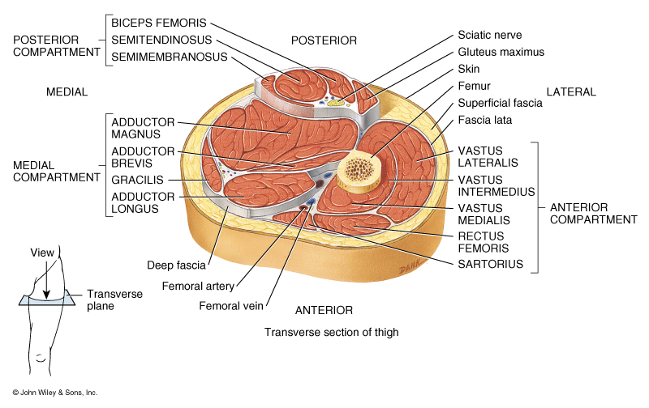
Organization of Skeletal Muscles at the gross level

Slide 7
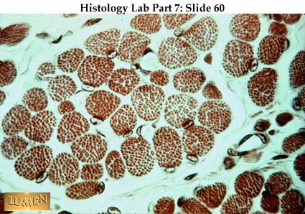
Organization of Skeletal Muscles at the gross level
Muscle fiber
Perimysium
Endomysium

Slide 8
Characteristics of Skeletal Muscle
Long cylindrical fibers that are multi-nucleated
Striated, composed of sarcomeres
Abundant sarcoplasmic reticulum for Ca 2+ storage
Contains transverse tubules
No gap junctions between cells
No autorhythmicity, voluntary nervous control
Fast speed of contraction
Acetylcholine regulation
Limited regeneration via satellite cells

Slide 9
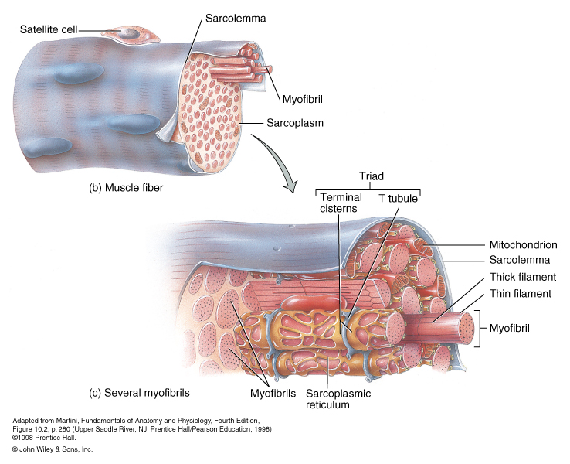
Organization of Skeletal Muscles at the microscopic level
Sarcolemma: cytoplasmic membrane plus endomysium

Slide 10
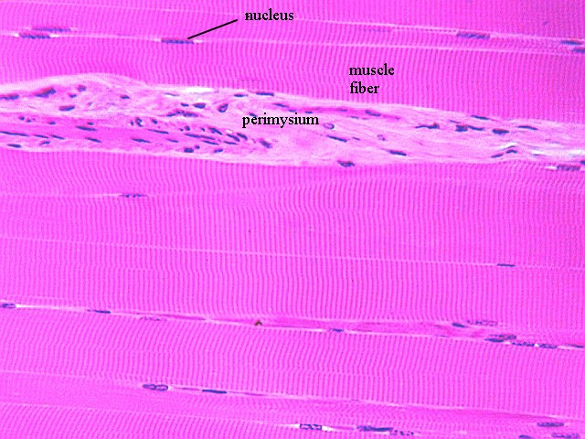
Organization of Skeletal Muscles at the microscopic level

Slide 11
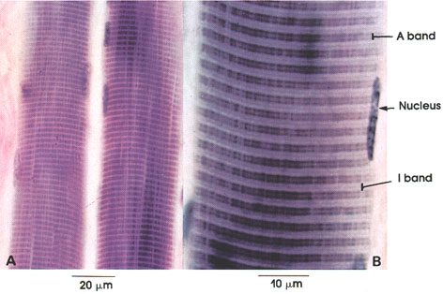
Organization of Skeletal Muscles at the microscopic level

Slide 12
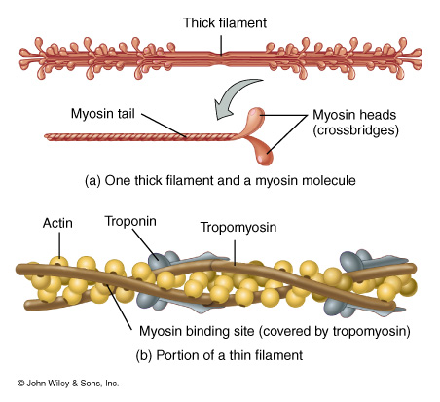
Organization of Skeletal Muscles at the microscopic level: Contractile Proteins

Slide 13
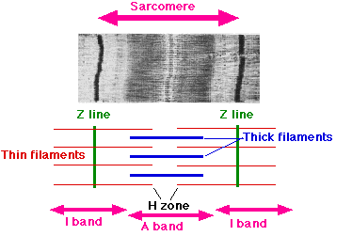
Organization of Skeletal Muscles at the microscopic level

Slide 14
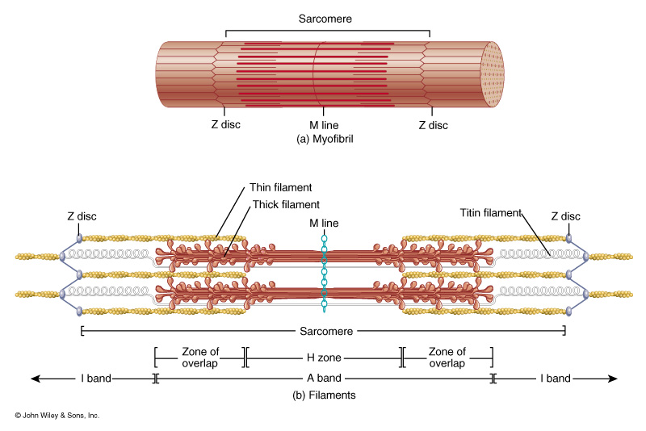
Organization of Skeletal Muscles at the microscopic level

Slide 15
Characteristics of Cardiac Muscle
Branched cylindrical fibers with one centrally-located nucleus
Intercalated discs join neighboring fibers, contain gap junctions
Striated, composed of sarcomeres
Some sarcoplasmic reticulum for Ca 2+ storage
Contains transverse tubules aligned with z-disc
Autorhythmicity, involuntary nervous control
Moderate speed of contraction
Acetylcholine, norepinephrine regulation
No regeneration

Slide 16
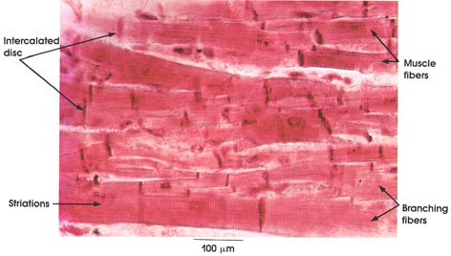
Organization of Cardiac Muscles at the microscopic level

Slide 17
Organization of Cardiac Muscles
at the microscopic level

Slide 18
Characteristics of Smooth Muscle
Spindle-shaped fibers with single nucleus
Not striated, not composed of sarcomeres
Only scant sarcoplasmic reticulum for Ca 2+ storage
Contains no transverse tubules
Gap junctions between cells in visceral organs
Autorhythmicity, involuntary nervous control
Slow speed of contraction
Acetylcholine, norepinephrine regulation
Considerable regeneration via spericytes

Slide 19
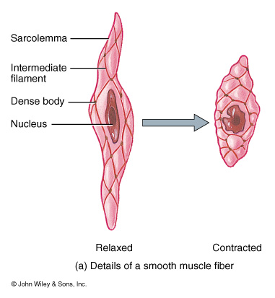
Histology of Smooth Muscle

Slide 20
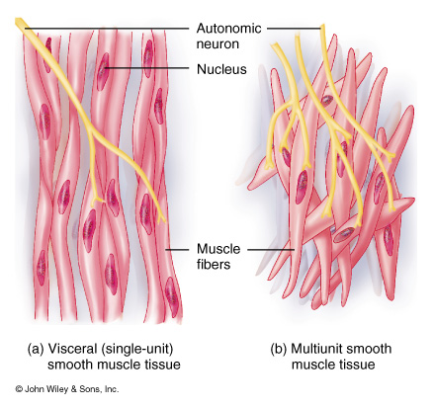
Histology of Smooth Muscle

Slide 21
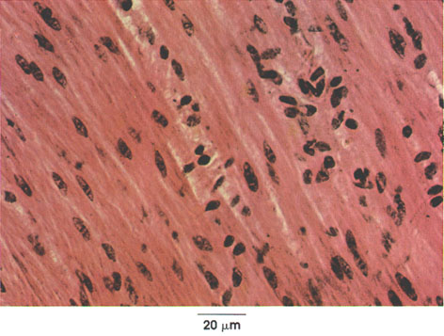
Histology of Smooth Muscle

Slide 22
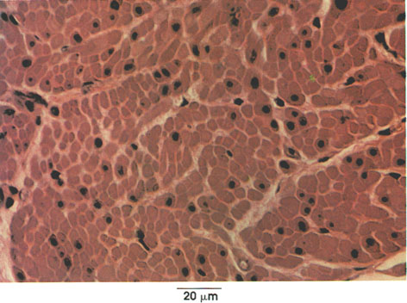
Histology of Smooth Muscle

Slide 23
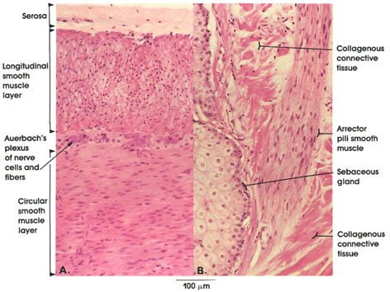
Histology of Smooth Muscle

Slide 24
1. Action potential (electrical stimulation) from somatic (motor) nerve stimulates skeletal muscle fibers (cells) at neuromuscular junction 2. “AP” causes the opening of Na+ channels on the sarcolemma thus causing a wave of depolarization to travel from the neuromuscular junction. 3. Depolarization event is communicated deep into the sarcoplasm via t-tubules. 4. Depolarization of sarcoplasmic reticulum causes the opening of Ca2+ channels and the subsequent release of calcium from sarcoplasmic reticulum 5. Calcium binds to troponin, troponin molecules change shape causing tropomyosin to move off of crossbridge binding sites on actin
Sequence of Events in Skeletal Muscle Contraction

Slide 25
Sequence of Events in Skeletal Muscle Contraction
6. Myosin crossbridges bind to crossbridge binding sites on actin 7. ATPase acts on ATP in the binding site on the myosin to convert it into ADP + Pi + ENERGY 8. Released kinetic energy causes a “power-stroke” which causes actin to slide over myosin (i.e. a contraction occurs) 9. Sarcolemma repolarizes due to the opening of potassium channels.
10. Calcium channels close and an active transport pump carries calcium back to sarcoplamic reticulum, troponin returns to pre-calcium shape, and ATP reforms to release the actin-myosin bond

Slide 26
1. Action potential (electrical stimulation) from somatic (motor) nerve stimulates skeletal muscle fibers (cells) at neuromuscular junction 2. “AP” causes the opening of Na+ channels on the sarcolemma thus causing a wave of depolarization to travel from the neuromuscular junction. 3. Depolarization event is communicated deep into the sarcoplasm via t-tubules. 4. Depolarization of sarcoplasmic reticulum causes the opening of Ca2+ channels and the subsequent release of calcium from sarcoplasmic reticulum 5. Calcium binds to troponin, troponin molecules change shape causing tropomyosin to move off of crossbridge binding sites on actin
Sequence of Events in Skeletal Muscle Contraction

Slide 27
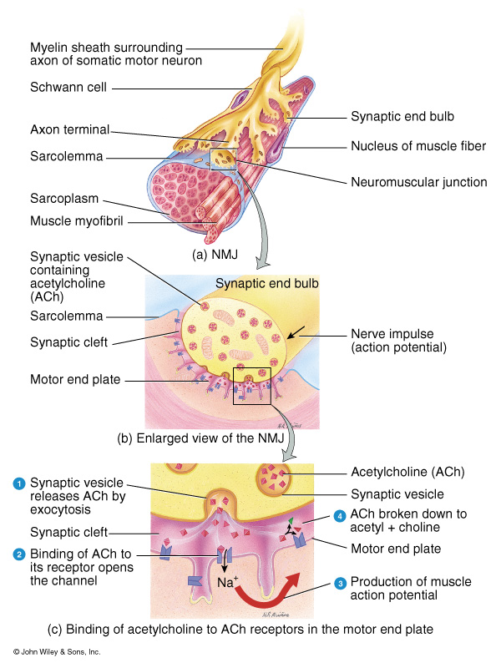
Neuromuscular junction

Slide 28
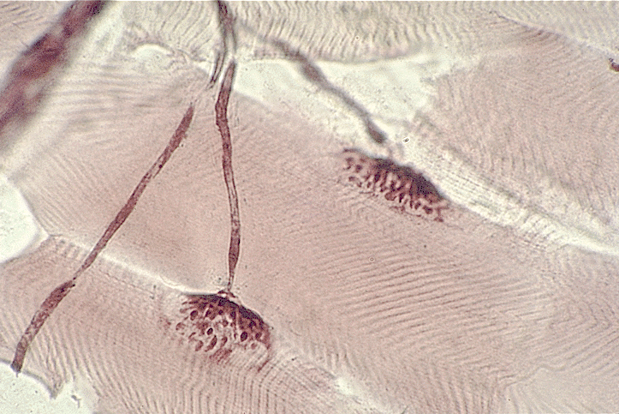
Neuromuscular junction, microscopic view

Slide 29
1. Action potential (electrical stimulation) from somatic (motor) nerve stimulates skeletal muscle fibers (cells) at neuromuscular junction 2. “AP” causes the opening of Na+ channels on the sarcolemma thus causing a wave of depolarization to travel from the neuromuscular junction. 3. Depolarization event is communicated deep into the sarcoplasm via t-tubules. 4. Depolarization of sarcoplasmic reticulum causes the opening of Ca2+ channels and the subsequent release of calcium from sarcoplasmic reticulum 5. Calcium binds to troponin, troponin molecules change shape causing tropomyosin to move off of crossbridge binding sites on actin
Sequence of Events in Skeletal Muscle Contraction

Slide 30
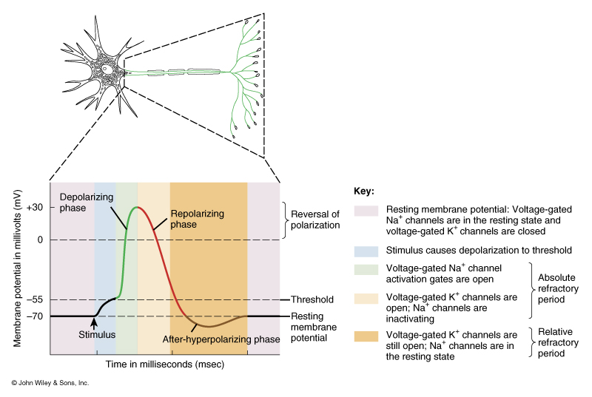
Sarcolemma membrane states

Slide 31
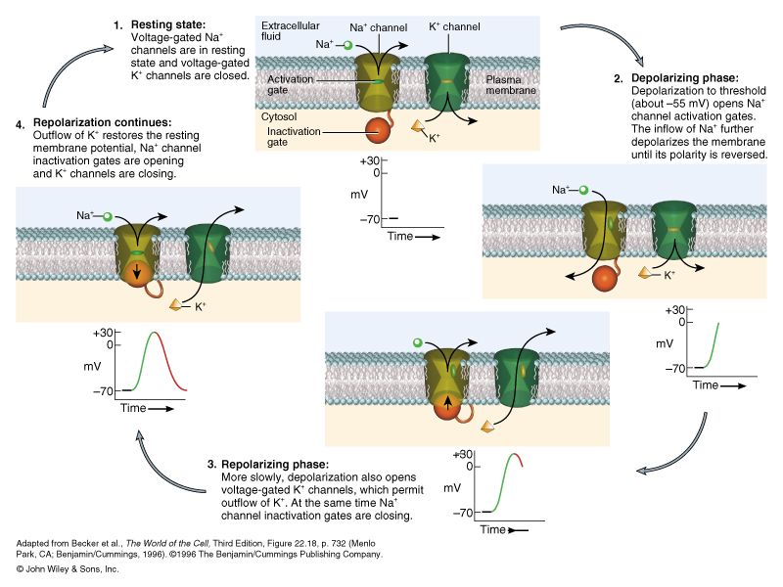
Action Potentials on the Sarcolemma

Slide 32
1. Action potential (electrical stimulation) from somatic (motor) nerve stimulates skeletal muscle fibers (cells) at neuromuscular junction 2. “AP” causes the opening of Na+ channels on the sarcolemma thus causing a wave of depolarization to travel from the neuromuscular junction. 3. Depolarization event is communicated deep into the sarcoplasm via t-tubules. 4. Depolarization of sarcoplasmic reticulum causes the opening of Ca2+ channels and the subsequent release of calcium from sarcoplasmic reticulum 5. Calcium binds to troponin, troponin molecules change shape causing tropomyosin to move off of crossbridge binding sites on actin
Sequence of Events in Skeletal Muscle Contraction

Slide 33
Organization of Skeletal Muscles at the microscopic level

Slide 34
1. Action potential (electrical stimulation) from somatic (motor) nerve stimulates skeletal muscle fibers (cells) at neuromuscular junction 2. “AP” causes the opening of Na+ channels on the sarcolemma thus causing a wave of depolarization to travel from the neuromuscular junction. 3. Depolarization event is communicated deep into the sarcoplasm via t-tubules. 4. Depolarization of sarcoplasmic reticulum causes the opening of Ca2+ channels and the subsequent release of calcium from sarcoplasmic reticulum 5. Calcium binds to troponin, troponin molecules change shape causing tropomyosin to move off of crossbridge binding sites on actin
Sequence of Events in Skeletal Muscle Contraction

Slide 35
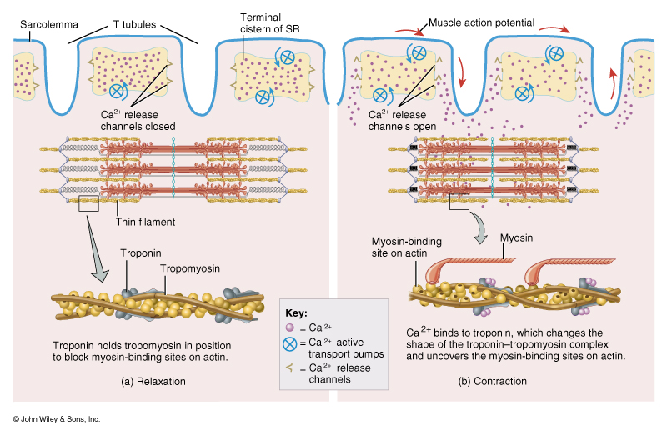
Calcium Troponin-Tropomyosin Interaction

Slide 36
Sequence of Events in Skeletal Muscle Contraction
6. Myosin crossbridges bind to crossbridge binding sites on actin 7. ATPase acts on ATP in the binding site on the myosin to convert it into ADP + Pi + ENERGY 8. Released kinetic energy causes a “power-stroke” which causes actin to slide over myosin (i.e. a contraction occurs) 9. Sarcolemma repolarizes due to the opening of potassium channels.
10. Calcium channels close and an active transport pump carries calcium back to sarcoplasmic reticulum, troponin return to pre-calcium shape, and ATP reforms to release the actin-myosin bond

Slide 37
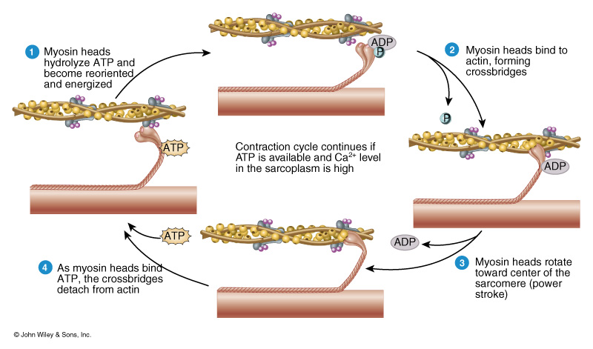
Actin-Myosin Interaction

Slide 38
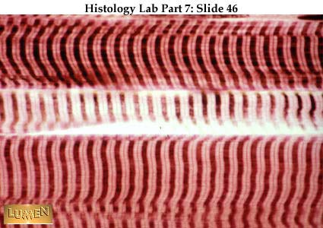
Organization of Skeletal Muscles at the microscopic level
Sarcomere
I band
A band

Slide 39
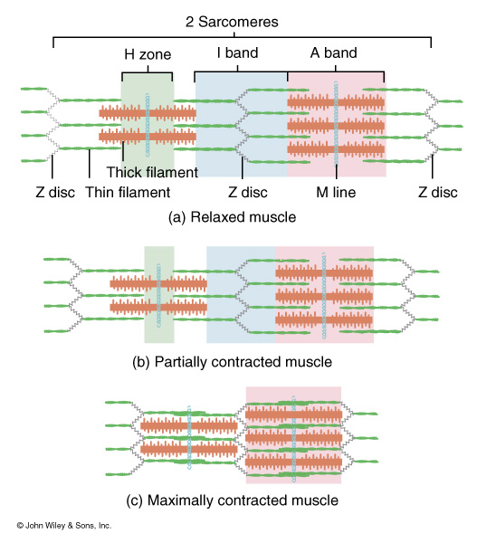
Results of actin-myosin interaction

Slide 40
Sequence of Events in Skeletal Muscle Contraction
6. Myosin crossbridges bind to crossbridge binding sites on actin 7. ATPase acts on ATP in the binding site on the myosin to convert it into ADP + Pi + ENERGY 8. Released kinetic energy causes a “power-stroke” which causes actin to slide over myosin (i.e. a contraction occurs) 9. Sarcolemma repolarizes due to the opening of potassium channels.
10. Calcium channels close and an active transport pump carries calcium back to sarcoplasmic reticulum, troponin return to pre-calcium shape, and ATP reforms to release the actin-myosin bond

Slide 41
Action Potentials on the Sarcolemma

Slide 42
Sarcolemma membrane states

Slide 43
Sequence of Events in Skeletal Muscle Contraction
6. Myosin crossbridges bind to crossbridge binding sites on actin 7. ATPase acts on ATP in the binding site on the myosin to convert it into ADP + Pi + ENERGY 8. Released kinetic energy causes a “power-stroke” which causes actin to slide over myosin (i.e. a contraction occurs) 9. Sarcolemma repolarizes due to the opening of Potassium channels.
10. Calcium channels close and an active transport pump carries calcium back to sarcoplasmic reticulum, troponin return to pre-calcium shape, and ATP reforms to release the actin-myosin bond

Slide 44
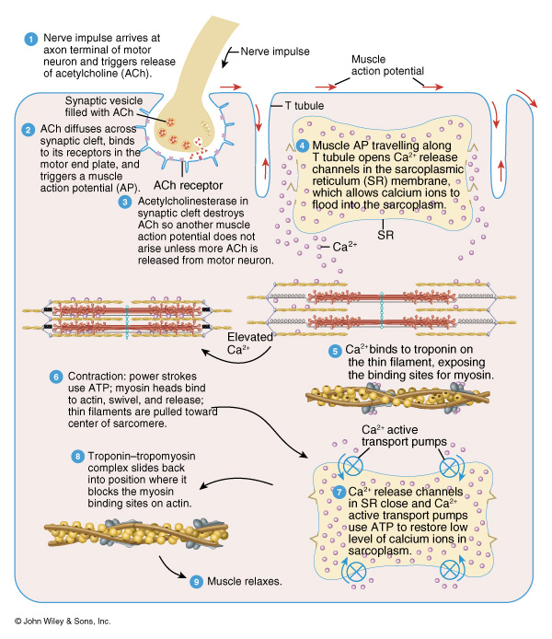
Return of Calcium into the Sarcoplasmic Reticulum

